Slide 1
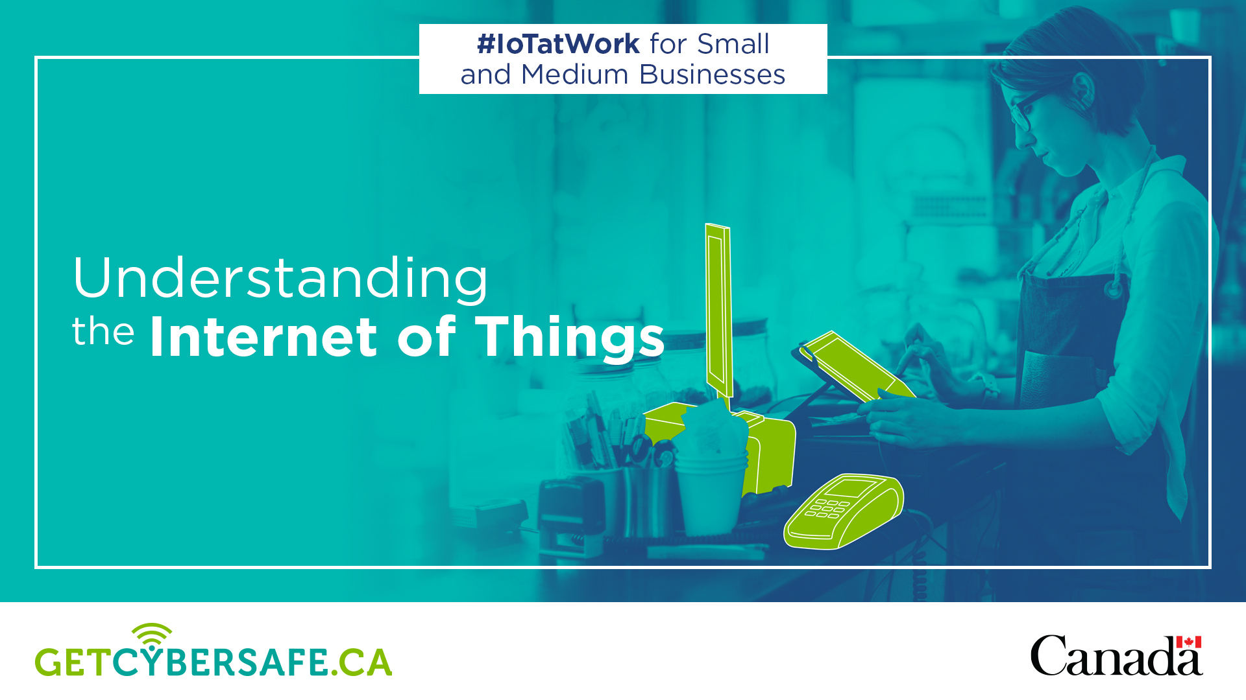
Notes:
Hello, Today we will look at cyber security and the Internet of Things and how it could impact our business.

Slide 2
Agenda
What is the Internet of Things?
How does it work?
What sectors use the IoT?
IoT Business developments
Risks to information security
Risks to privacy
Risks to safety
IoT Security checklist
Notes:
We’ll cover the basics of the IoT, where it is being used across business sectors, and the possible risks it could place on our business. Finally, we will leave you with some security procedures and practices to follow to protect our business.

Slide 3
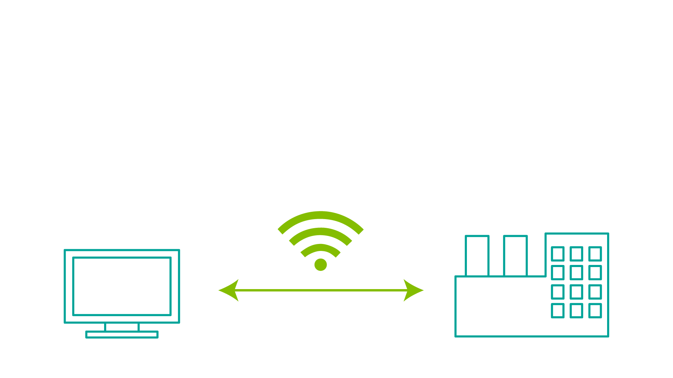
What is the Internet of Things?
The Internet of Things (IoT) is a network of ‘smart’ devices that connect and communicate via the Internet.
Notes:
What is the Internet of Things? It’s a network of ‘smart’ devices that connect and communicate via the Internet. Smart devices are anything that connects to the Internet, from appliances to manufacturing equipment, from locks and security cameras to connected cars.

Slide 4
How does the IoT work?
Smart devices collect and exchange information machine to machine (M2M) and with us.
Remote control and monitoring
Operate automatically through software, cameras and sensors
Notes:
Smart devices collect and exchange information with each other (machine to machine) and with us, through our personal IoT devices like our phones.
These devices can be remotely controlled and monitored, but for the most part they operate automatically through software, cameras and sensors. Sensors detect things like light, sound, distance, movement, and much more.

Slide 5
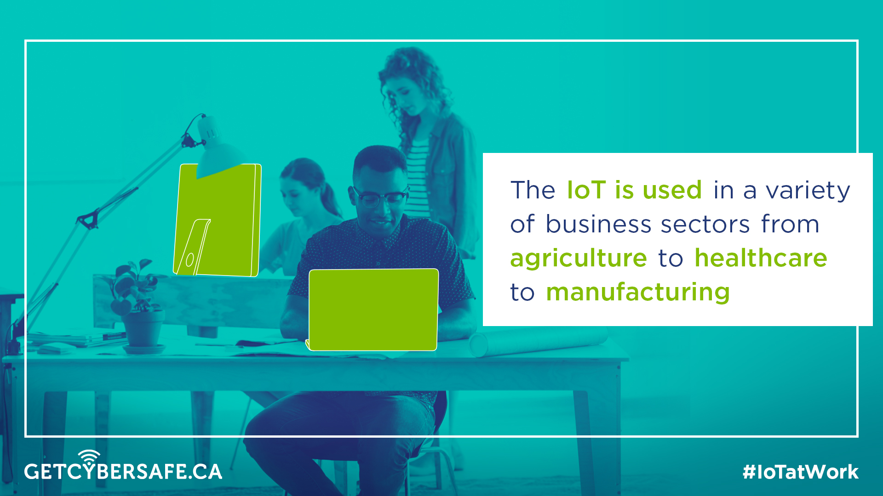
Notes:
The IoT is used in a variety of business sectors, from agriculture to healthcare to manufacturing.

Slide 6
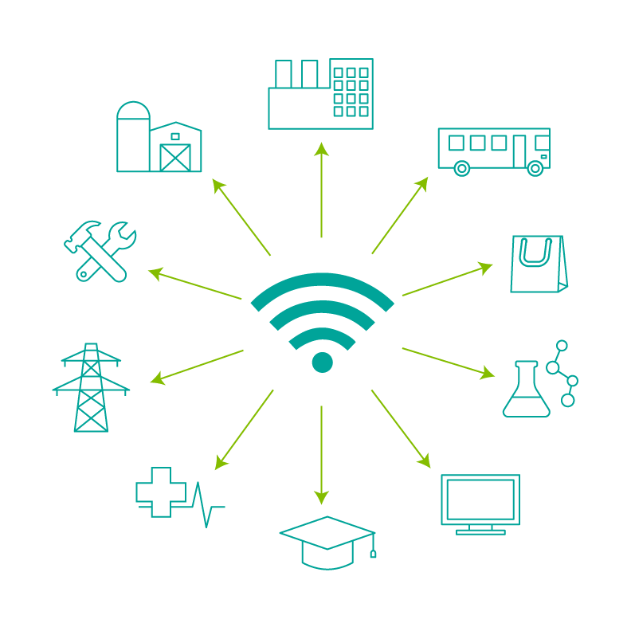
What sectors use the IoT?
Manufacturing
Transportation
Retail
Science and Technology
IT and Communications
Education
Healthcare
Energy
Construction
Agriculture
Notes:
Manufacturing
Transportation
Retail
Science and Technology
IT and Communications
Education
Healthcare
Energy
Construction
Agriculture

Slide 7
IoT business developments
Retail
Automated checkout
Inventory and warehouse management
Notes:
The IoT may help the retail industry to cut costs and increase efficiencies with automated checkout, and inventory and warehouse management.

Slide 8
IoT business developments
Manufacturing
Operations efficiencies
Asset management and maintenance
Notes:
The Industrial Internet of Things (IIoT) may help factories and manufacturing streamline operations and maintenance.

Slide 9
IoT business developments
Consumers
Entertainment
Health and fitness
Notes:
For consumers, the IoT may offer new entertainment products and advancements in health and fitness.

Slide 10
IoT business developments
Offices and Government
Productivity and energy saving
Security and surveillance
Notes:
Offices and governments may increase productivity, save energy, and enhance security and surveillance with the IoT.

Slide 11
IoT business developments
Transportation
Automation and traffic control
Fleet management
Notes:
The IoT may transform the transportation industry with the efficiencies of connected, self-driving vehicles, traffic control and fleet management.

Slide 12
IoT business developments
Healthcare
Monitoring
Automated administration of treatment
Notes:
The IoT may further advance healthcare with remote monitoring and automated administration of treatment.

Slide 13
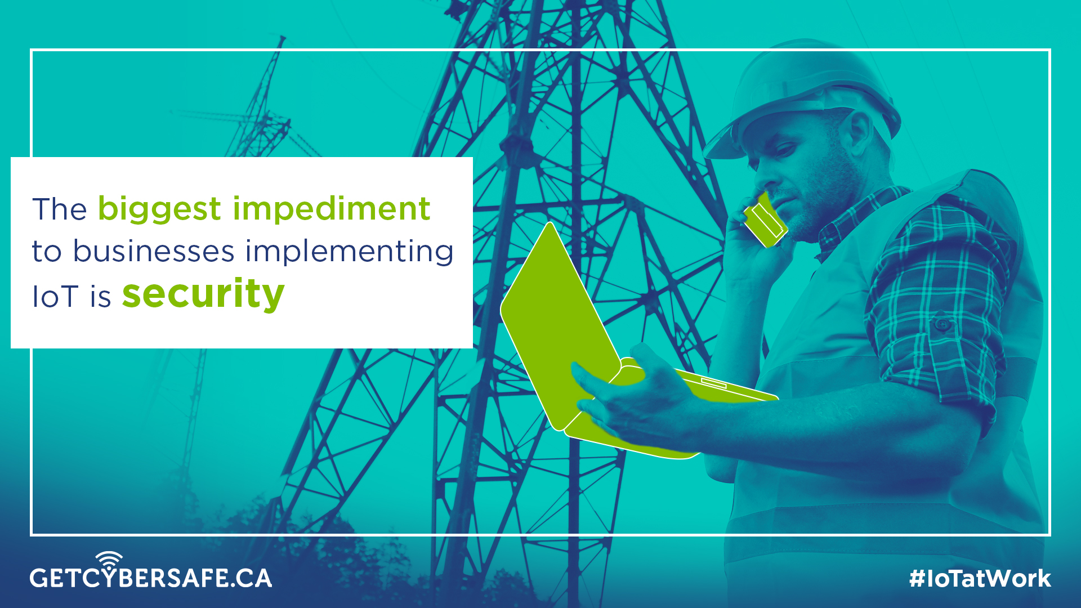
Notes:
Despite the possibilities of the IoT, the biggest impediment to businesses implementing IoT is security.

Slide 14
Risks to Information Security
Possible consequences of an information breach:
Loss of reputation/credibility
Loss of revenue and time
Lead to legal challenges
Notes:
An information breach caused by a cyber incident could have serious consequences to a business’s reputation and credibility, could cause a loss of revenue and time, and could lead to legal challenges.

Slide 15
Risks to Information Security
Direct cyber incidents:
Remote control and monitoring
From head office, to supply chain, to customers
Indirect cyber incidents (viral threats, malware):
Downstream effects on IT security infrastructure
A malware attack on the IoT device manufacturer could affect your IoT devices
Notes:
A direct cyber incident affects the targeted IoT device, and all other devices or networks that are connected to it, such as devices on the business network, or even our personal devices. An indirect cyber incident, such as malware, has downstream effects on a business’ IT infrastructure. For example, if the developer/manufacturer of IoT devices is affected by malware, any IoT devices from that manufacturer could be vulnerable to the same malware incident.

Slide 16
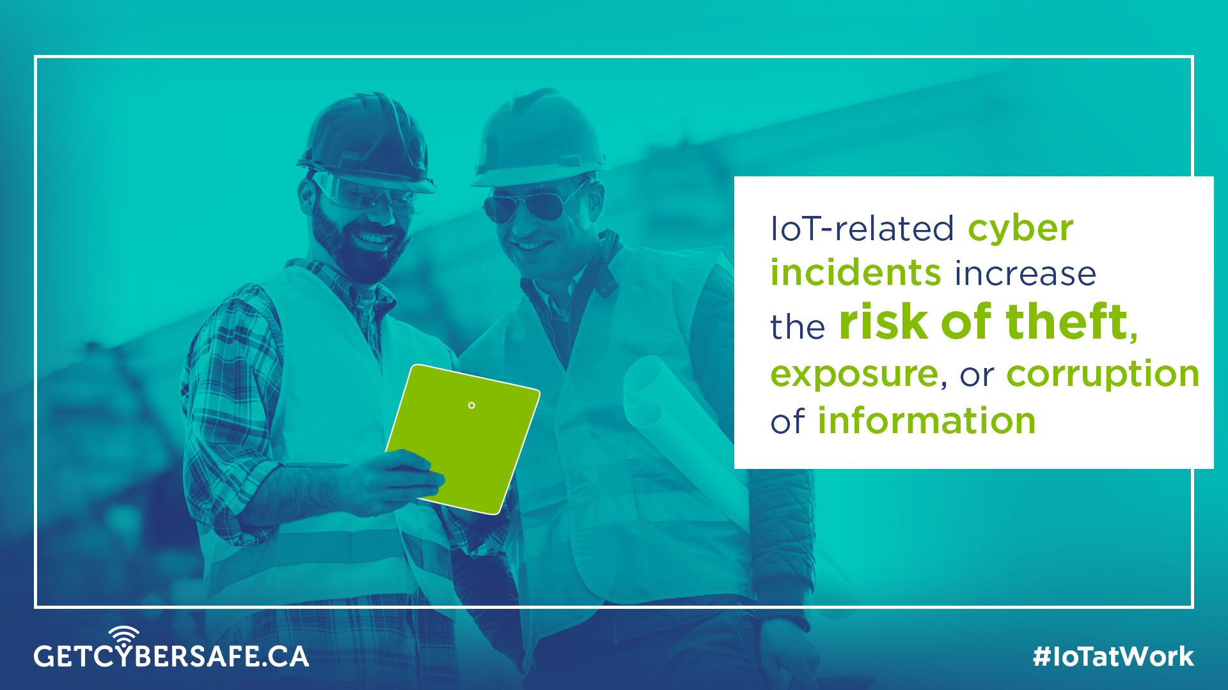
Notes:
With every connection comes an increase in vulnerability. IoT-related cyber incidents increase the risk of theft, exposure, or corruption of information.

Slide 17
Risks to Privacy
Business, employee, and client information could be:
Destroyed
Altered
Stolen and exposed
Held for ransom
Notes:
If you do not control who and what connects to your network you cannot protect the information that traverses it. In a cyber incident, business, employee, and client information could be destroyed, altered, stolen and exposed, or even held for ransom.

Slide 18
Risks to Privacy
Understand IoT device data collection policies:
What information is gathered?
How long is data kept?
What is your data used for (marketing research, etc.)?
Notes:
IoT devices collect vast amounts of data, which creates concern over the confidentiality, privacy, and integrity of business data. Ensure to use IoT devices that provide transparency on their data collection policies. It is important to understand what information is being gathered, how long it is kept, and what it’s used for, such as marketing research or customer service.

Slide 19
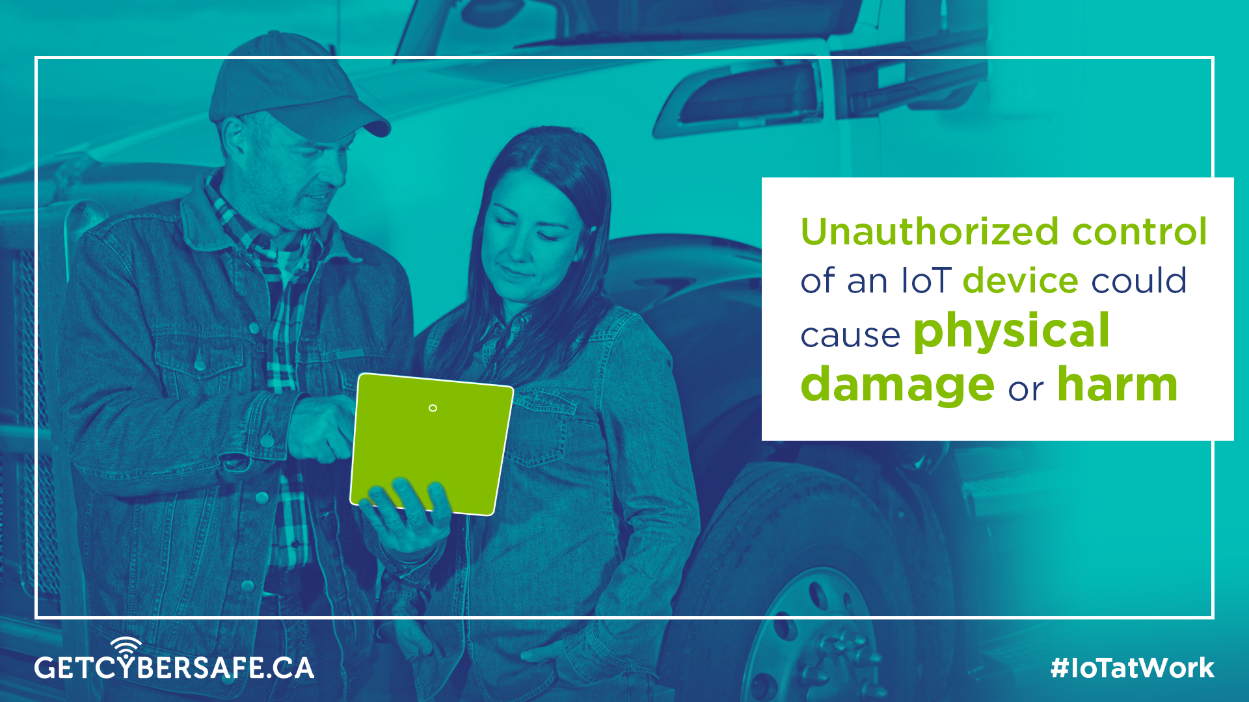
Notes:
The unauthorized control or remote takeover of an IoT device could cause physical damage to data and equipment, or even physical harm.

Slide 20
Risks to Safety
IoT device malfunction or manipulation could cause:
Physical damage to data
Physical damage to equipment
Physical harm
Notes:
For many devices, their operational roles can be far more important than the information they store. Imagine the consequences of a smart vehicle or insulin pump failing or being manipulated.

Slide 21
Risks to Safety
Possible consequences of IoT device malfunction or manipulation:
Costly repairs to systems, assets, and equipment
Legal impact of harm to staff, customers or public
Loss of reputation
Notes:
Damages could be costly to the business’s reputation and costly to recover systems, assets, and equipment. Also, consider the possible legal implications, and associated financial impact.

Slide 22
Before implementation:
Research devices before you purchase. Read reviews and get recommendations; research their security capabilities.
Have a point of contact with the manufacturers for any issues down the road.
Read device materials: operator’s manuals, instructions, support forums.
Create a Bring Your Own Device (BYOD) and IoT policies for employees.
Assess against your existing IT security policies and standards.
Notes:
With the IoT’s impact on business security, it is important that all employees and parts of the business are aware of what we can do to protect our information.
Slides 22 – 24: This checklist provides IT and management with tips to securely implement the IoT into our workplace.

Slide 23
During implementation:
Secure your wireless network.
Change device default usernames and passwords, and use strong passwords.
Keep networks with sensitive information isolated. Consider using separate networks for IoT devices.
Ensure the device has system reset capability in order to permanently eliminate sensitive configuration information.
Control who can access your network and from where.
Encrypt data, commands and communications, both at rest and in transit.
Where possible, set operating system, software, and firmware to update automatically. Establish periodic manual updates as required.
Notes:
This checklist provides IT and management with tips to securely implement the IoT into our workplace.

Slide 24
After implementation:
Implement a repeatable process to validate all safeguard and countermeasures in your implementation.
Conduct ‘cyber incident’ tests and audits regularly to ensure the integrity of your network.
Backup data regularly using secure and redundant storage solutions, such as multiple storage units and/or the cloud. Test your recovery process regularly.
Notes:
This checklist provides IT and management with a strategy to securely implement the IoT into our workplace.

Slide 25
Adhere to your company’s Bring Your Own Device/ IoT policy
Understand what information is being collected by devices and why, before you download or buy.
Use a lock screen password, use strong passwords.
Backup data regularly on multiple storage units and the cloud.
Connect only to secure Wi-Fi networks.
Use safe websites, cloud storage, etc.
Notes:
For you, (the employees) IoT security is very similar to existing cyber security practices. Things like using strong passwords and lock screens, connecting to secure Wi-Fi networks and backing up data are simple measures to protect yourself and our business.

